Slide 1
Geotechnical Data Standardisation Workshop Paris, 22 January 2019 Some UK Initiatives - AGS
Martin Nayembil
BGS

Slide 2
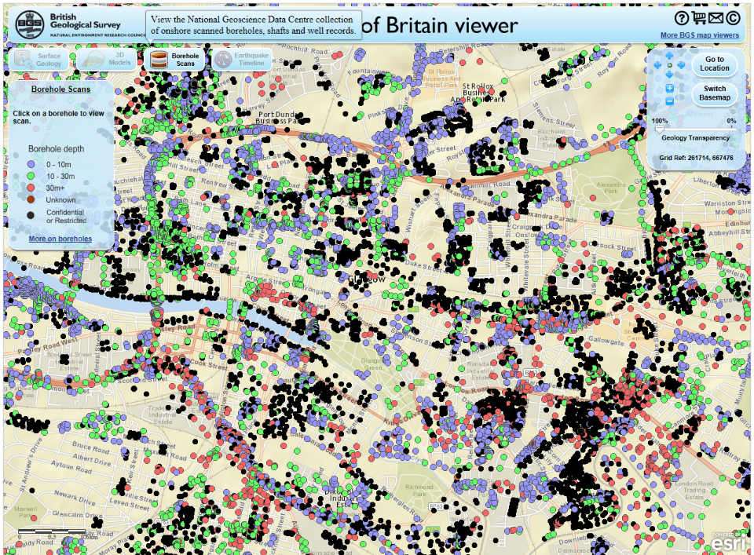
Why Geotechnical data?

Slide 3
BIM for the Subsurface 2 year project funded by InnovateUK
Unforeseen ground conditions-major causes of project delay contributing to ~ 1/3 of construction programme over-runs.
Partly due to limited availability of high quality geotechnical data & interpretation.
Project applied BIM process to ground investigation & subsurface infrastructure design.
Integrated with BGS’s national databases and implementing BGS methodologies & standards for 3D geological modelling.
Keynetix, Atkins, Autodesk

Slide 4
Building a National data Repository of Geotechnical data
As a designated Environmental Data Centre
Manage subsurface data and information from a range of differing geological or geoscience disciplines
Working with the geotechnical industry to facilitate the capture, validation, storage and dissemination of geotechnical data – tools integration for data capture and visualisation
Holds data from a variety of differing data sources;
NERC-UKRI funded grants (projects or programmes)
BGS science activities
Statutory datasets
Commercial voluntary data donations from a variety of differing organisations and communities
Improved understanding assisting Site investigation design, Local authorities and environmental regulators meet future legislation requirements
Data includes key metadata (e.g. location, borehole ID, borehole construction) reported with all associated data
Holds historical/legacy data up to real-time geological processes, sensor networks and data streams
Full compliance and completeness of AGS format files
Data accessible through various services and tools but also preserving this data for the long-term re-use

Slide 5
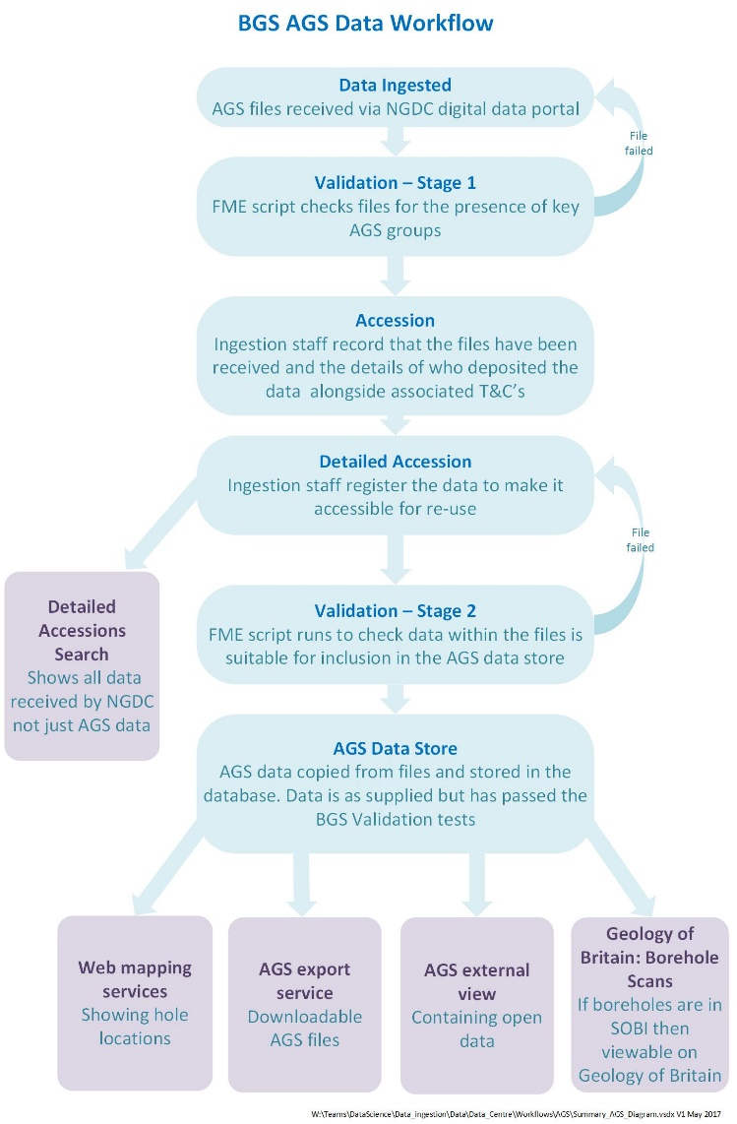
BGS AGS Data Workflow

Slide 6
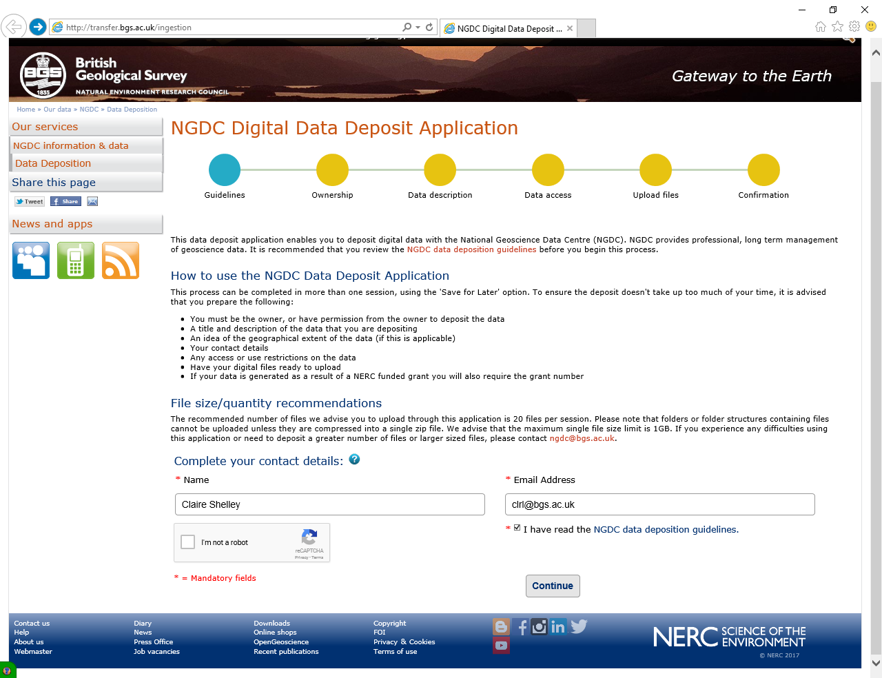
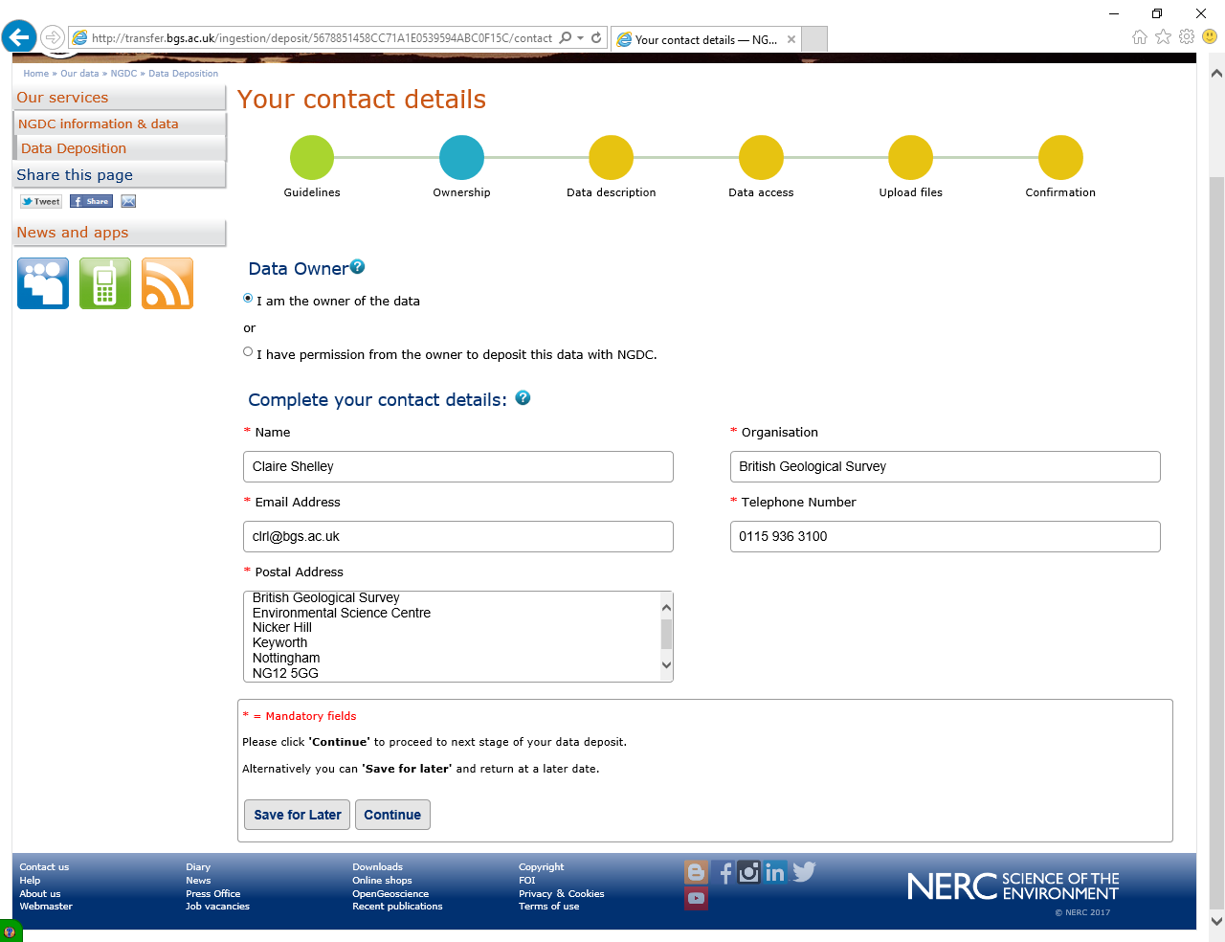
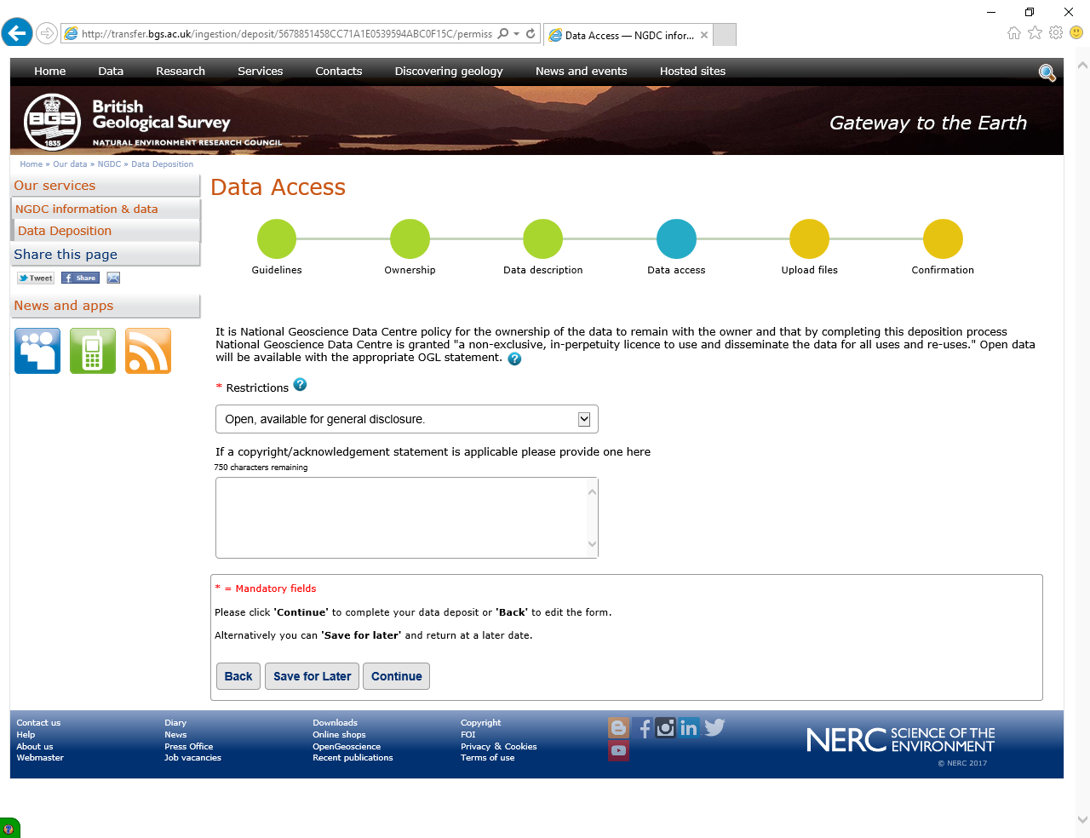
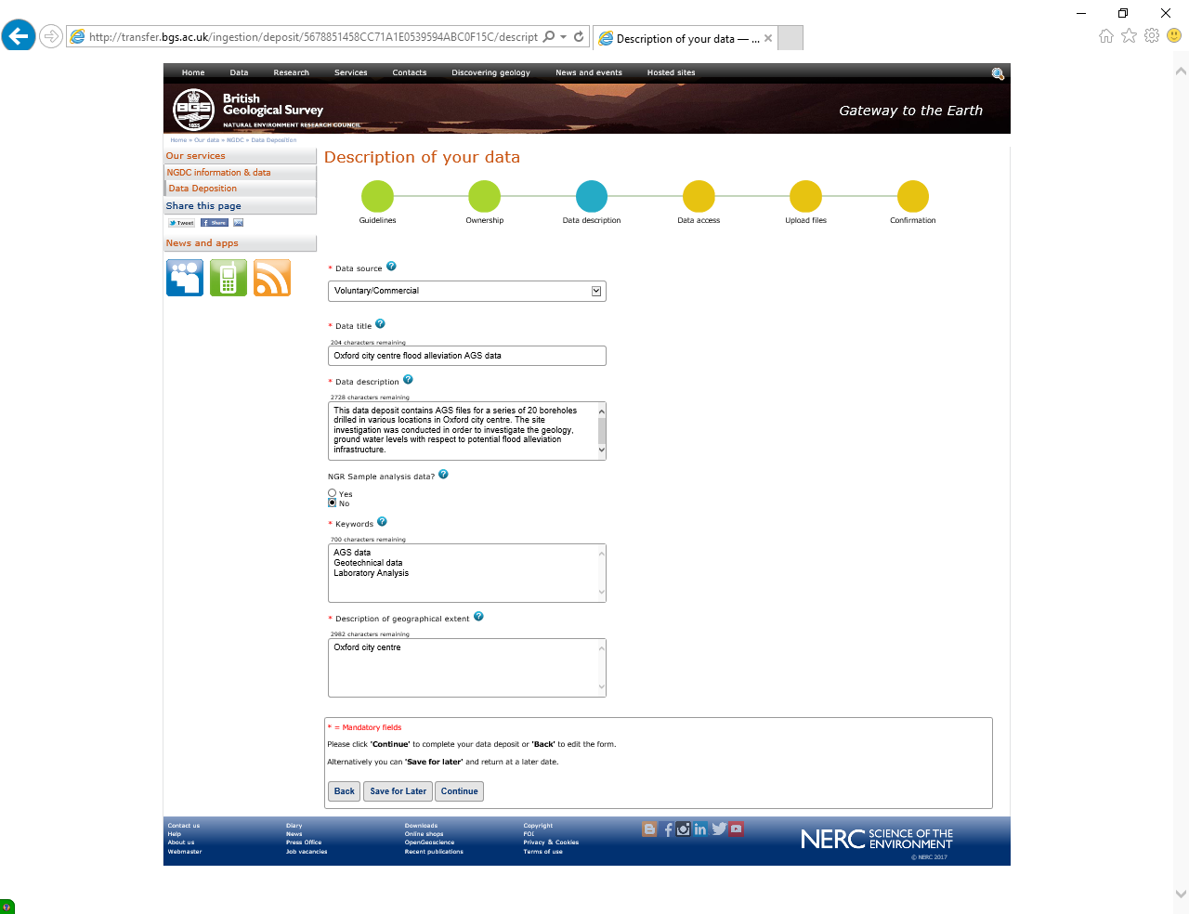
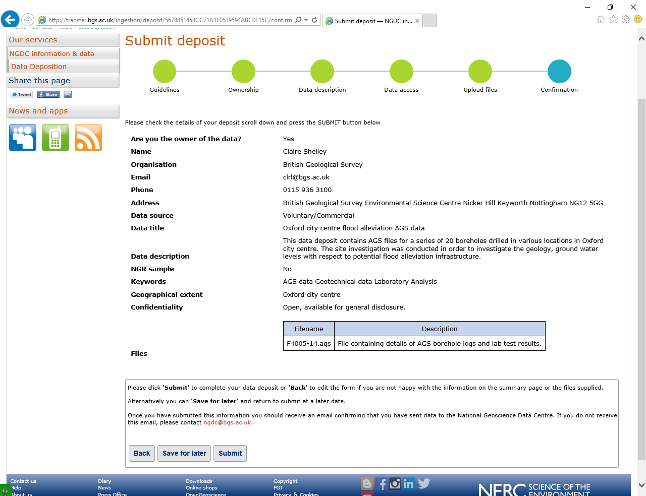
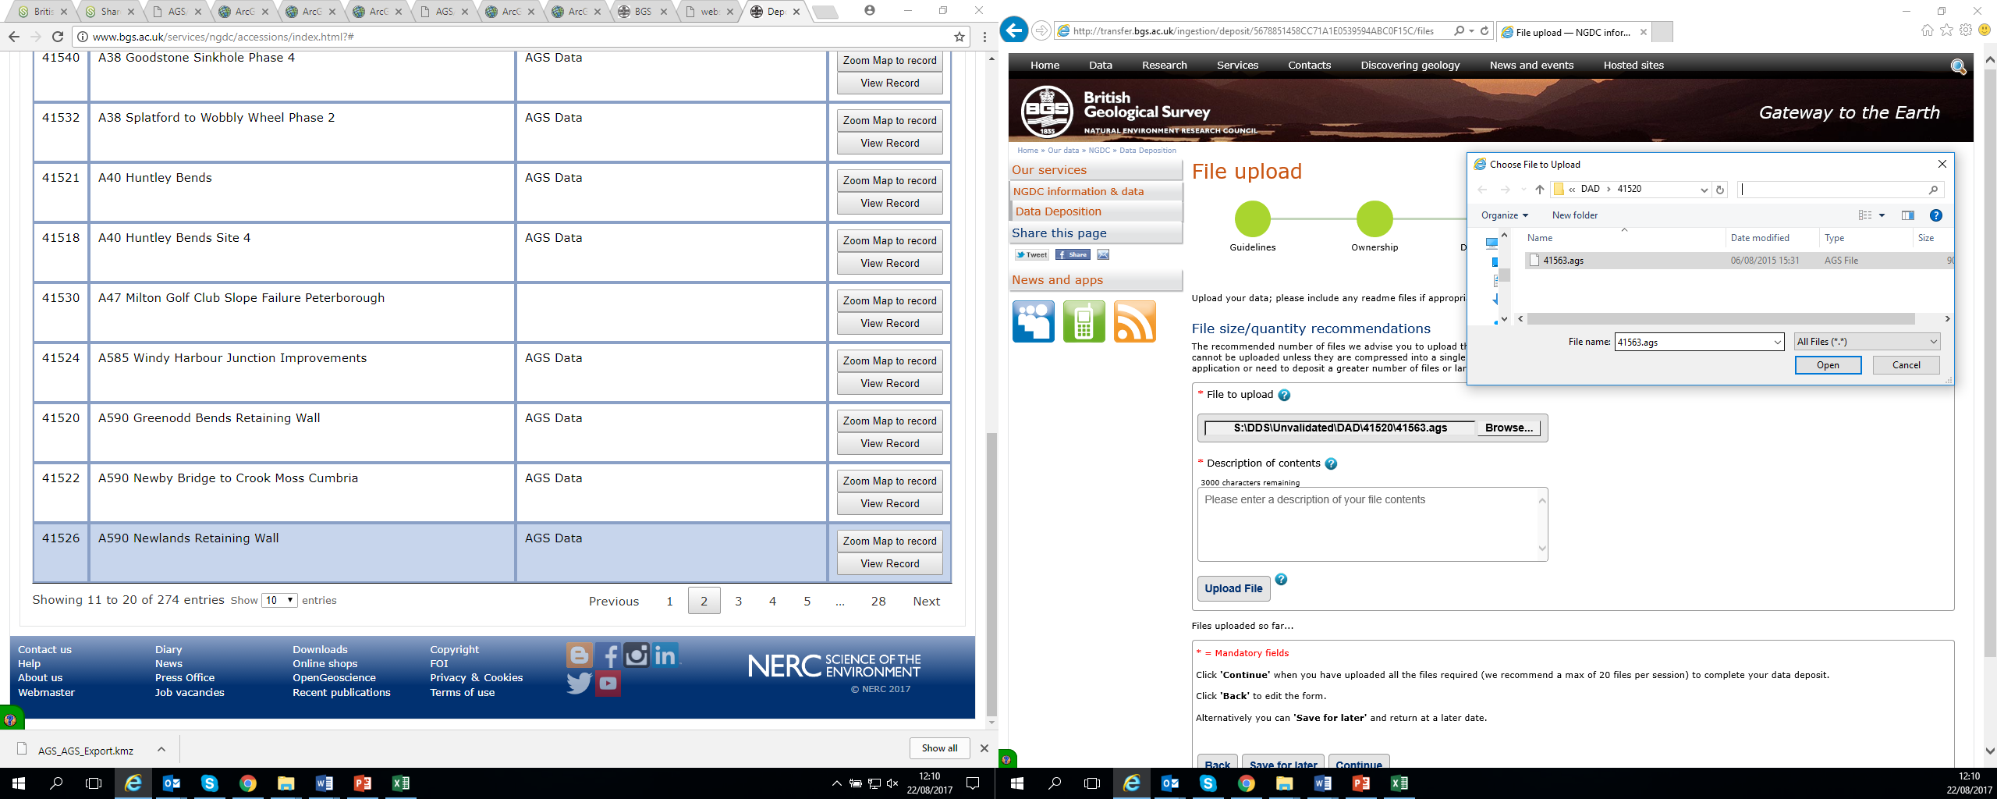
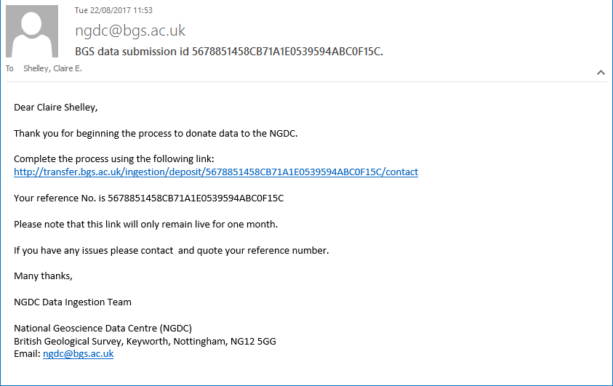
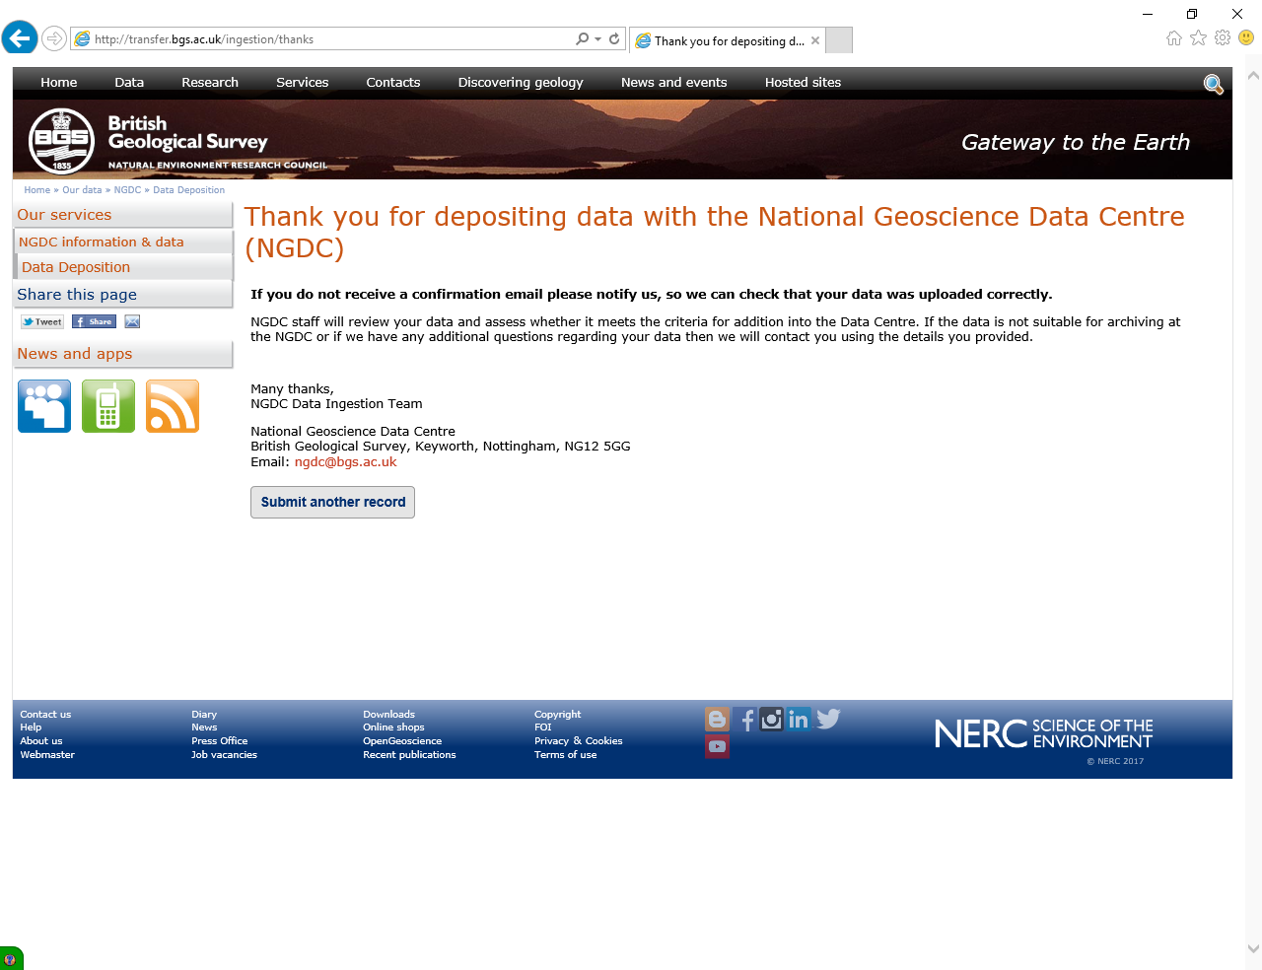
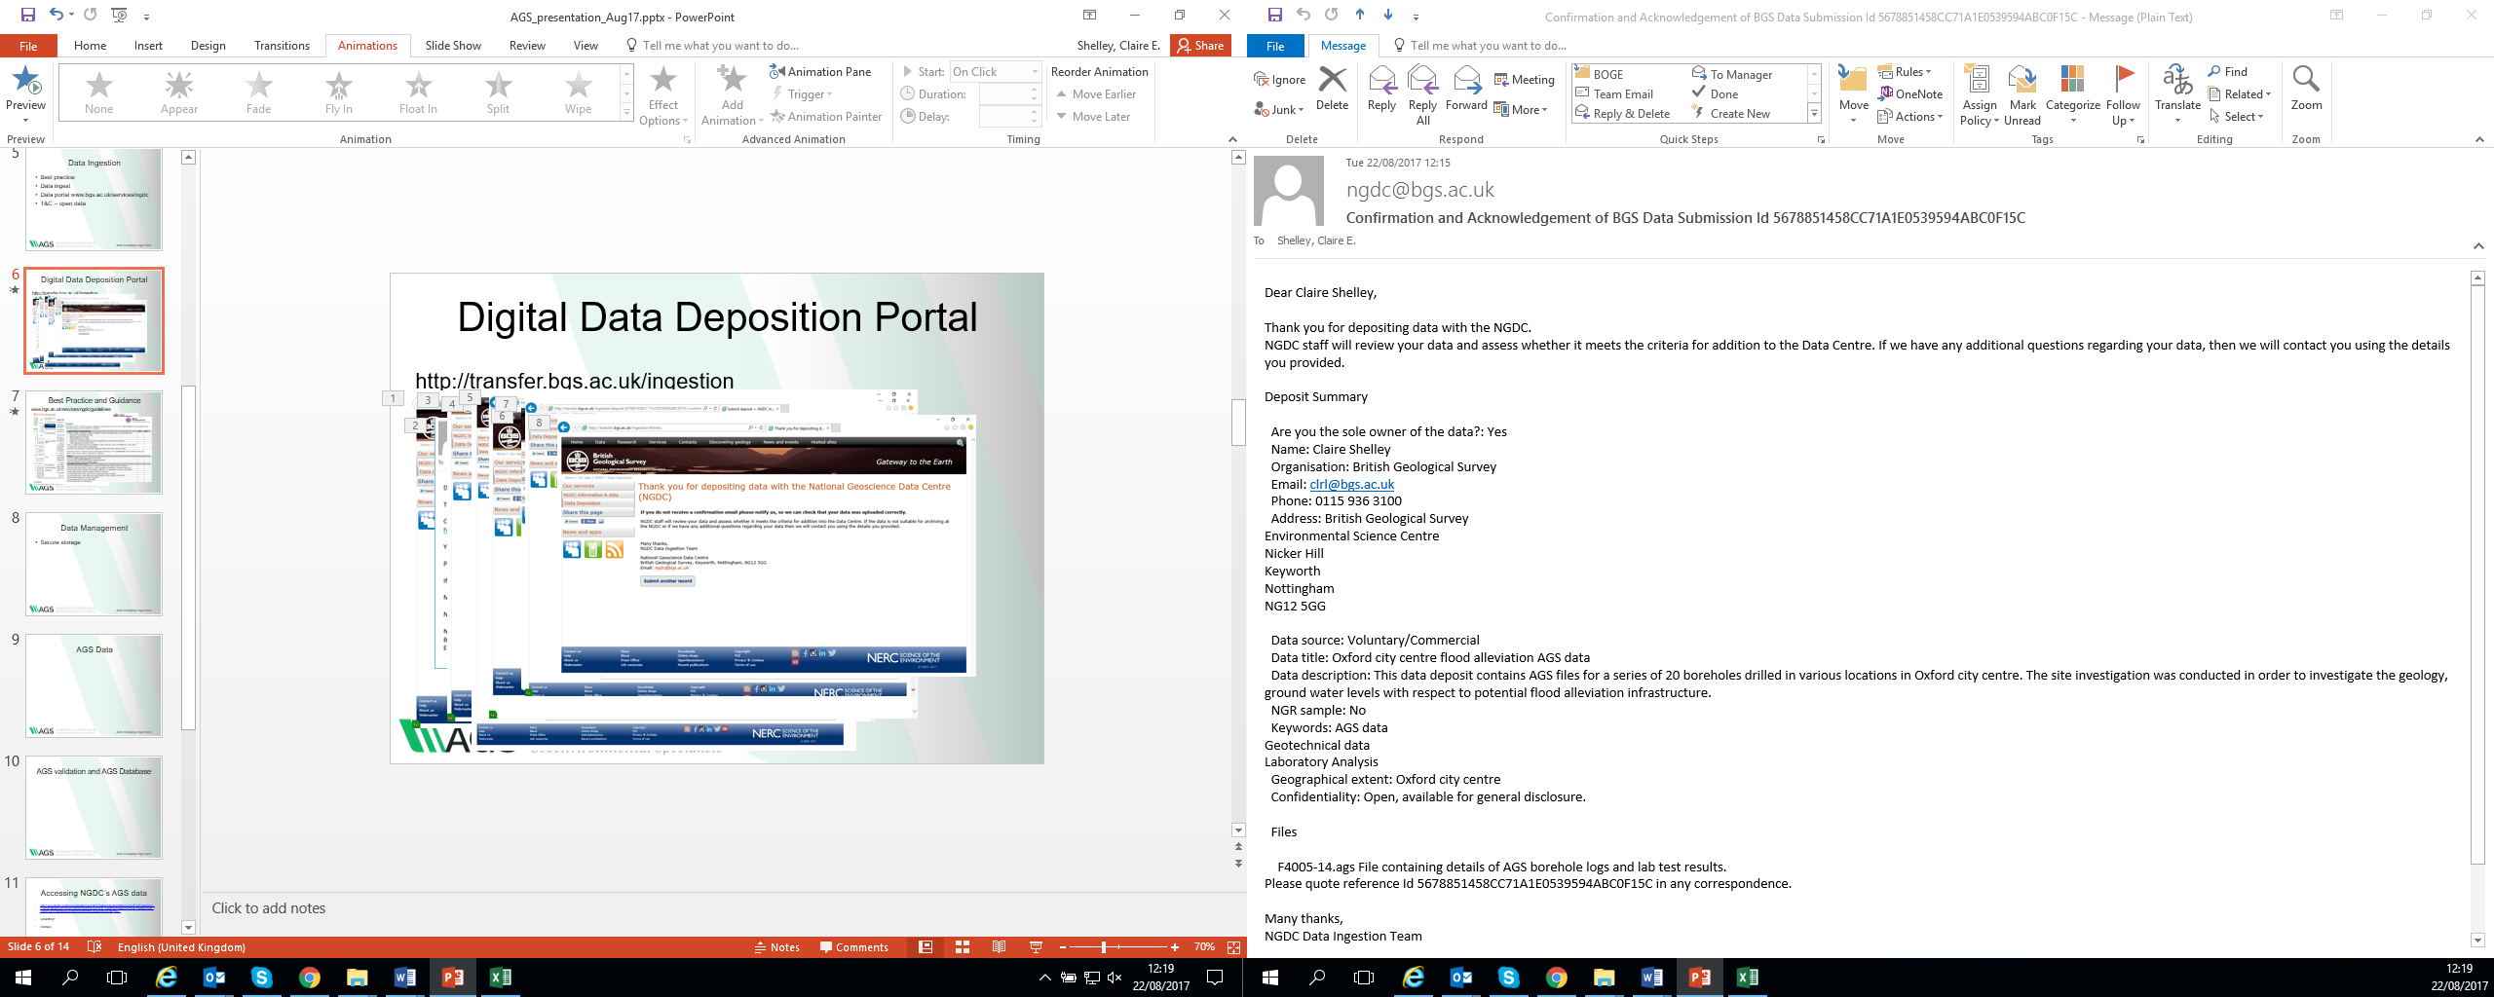
Digital Data Deposition Portal
http://transfer.bgs.ac.uk/ingestion

Slide 7
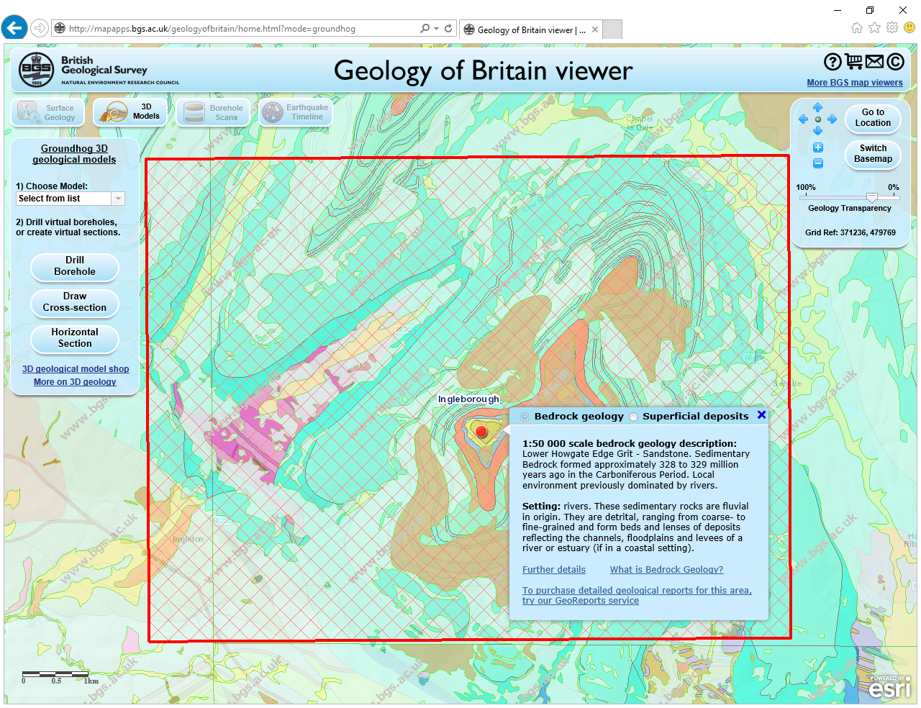
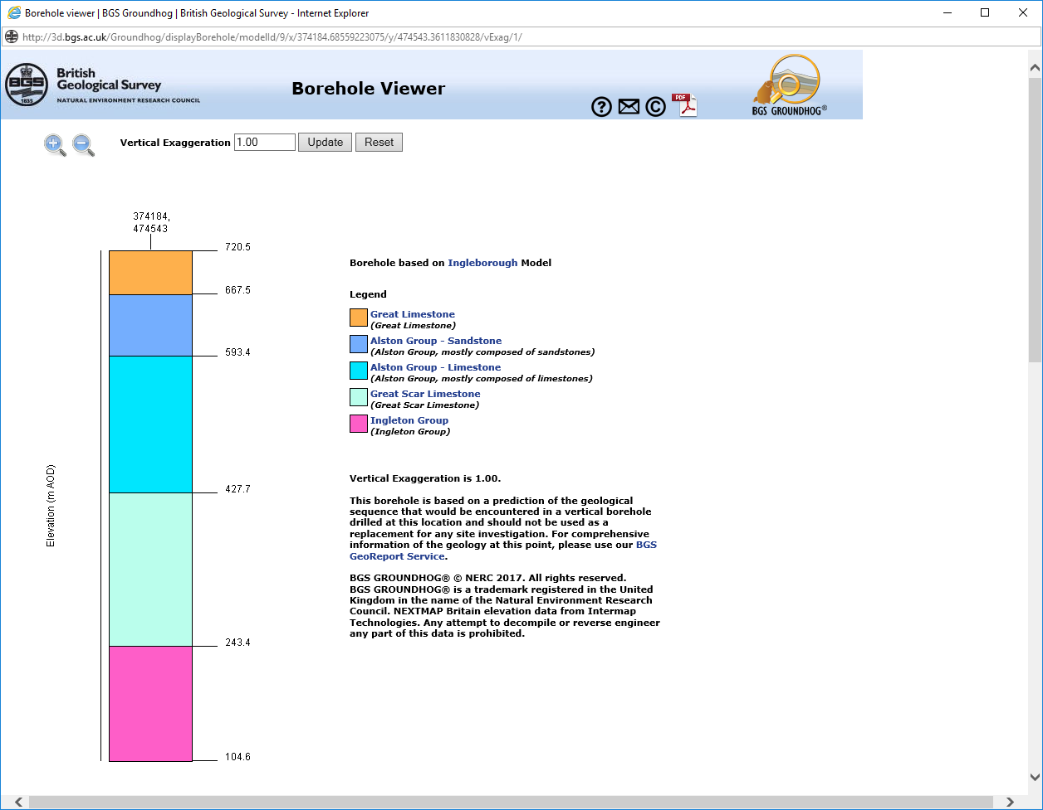
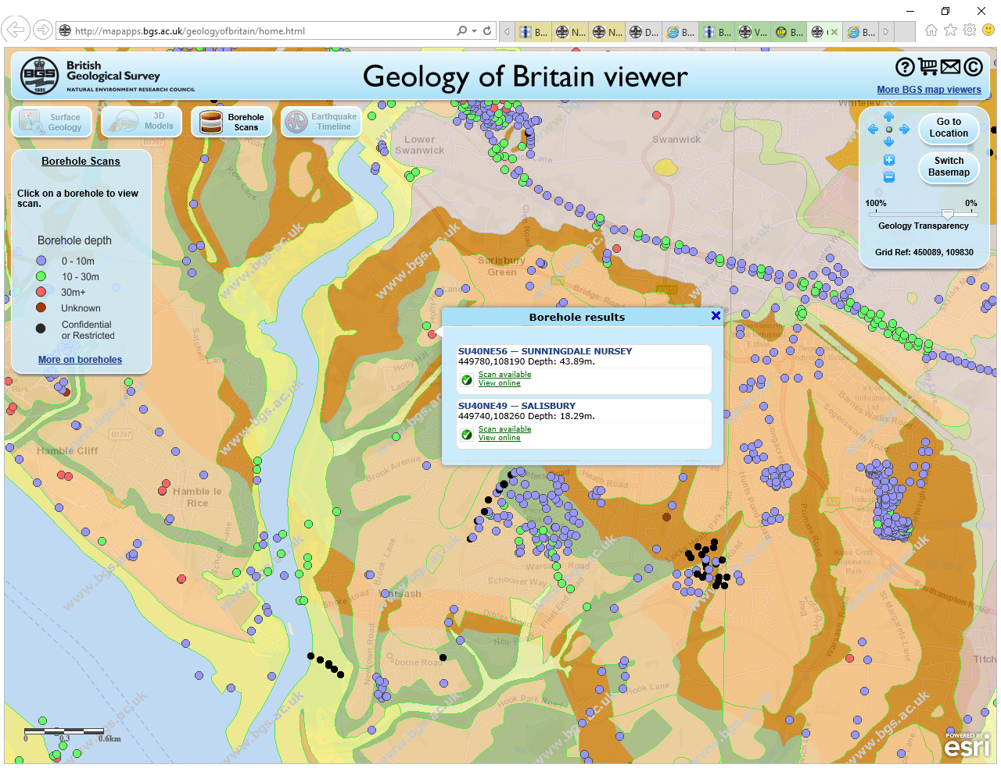
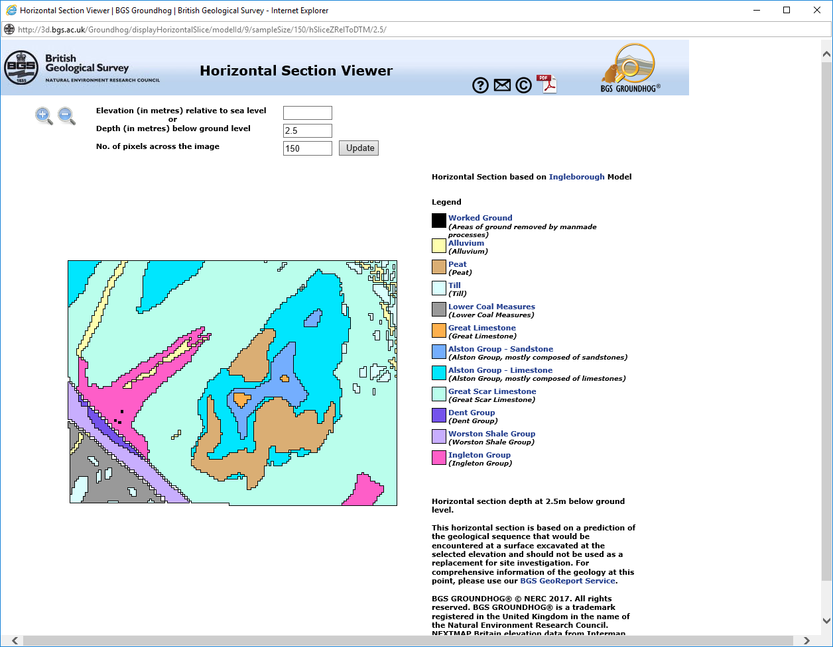
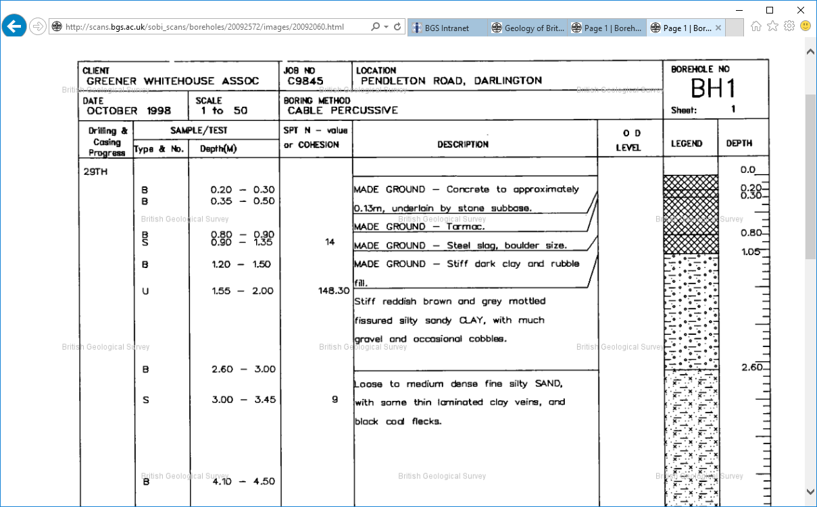
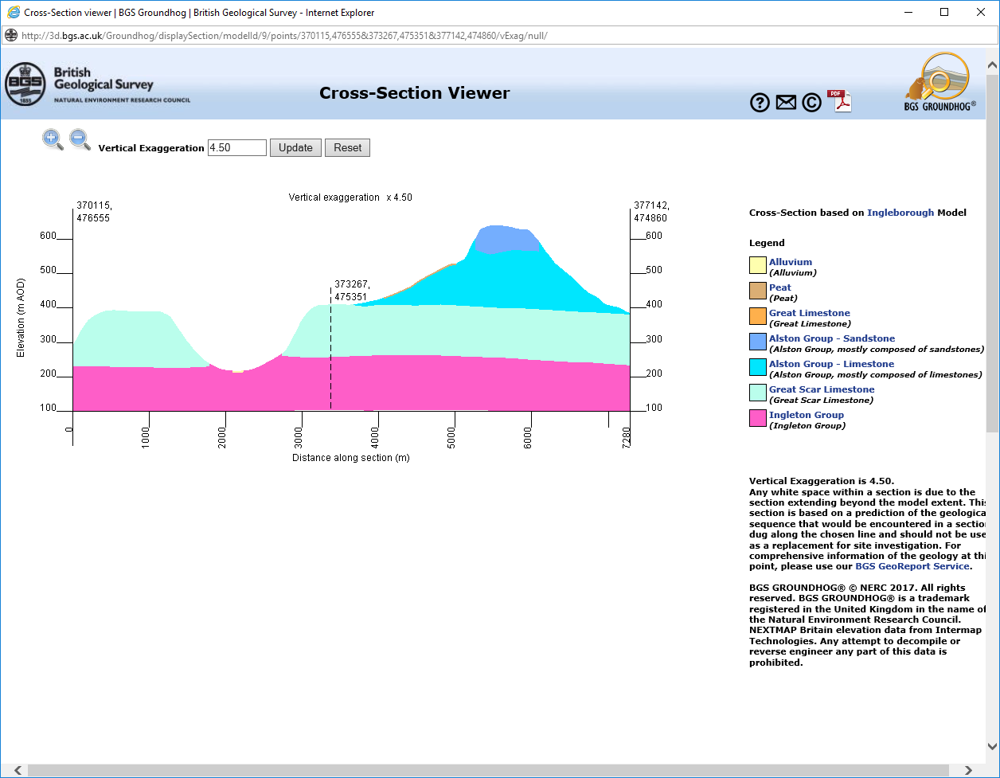
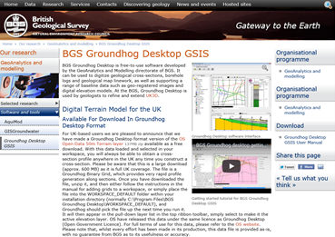
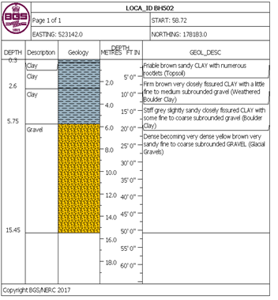
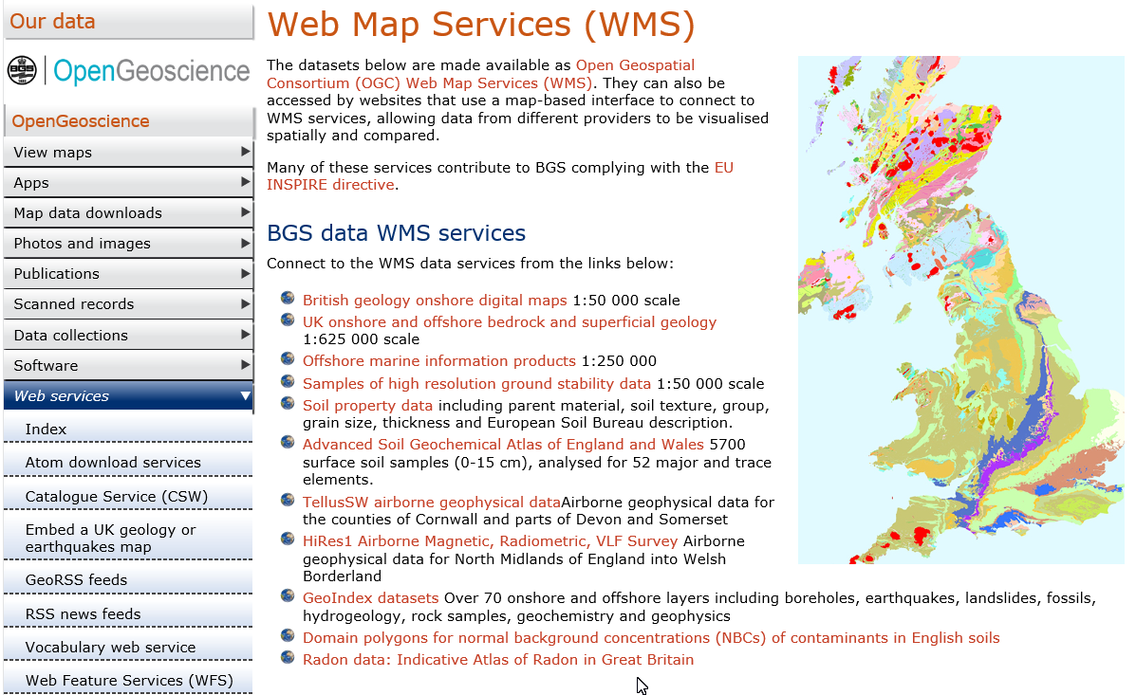
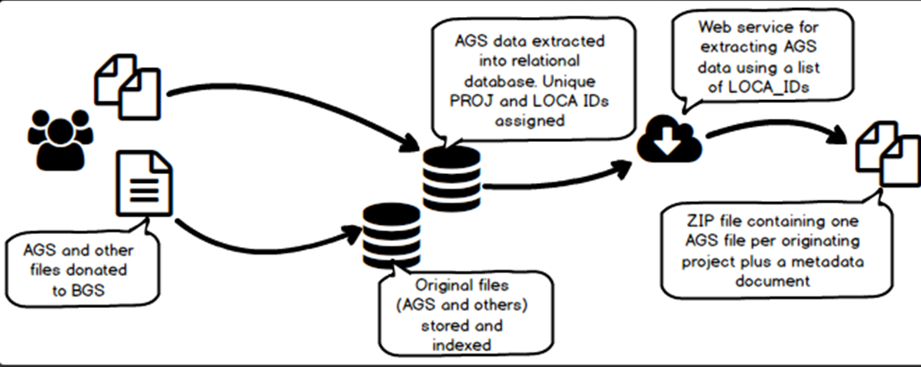
Accessing BGS/NGDC data
BGS OpenGeoscience (Web Services and Applications)
http://www.bgs.ac.uk/opengeoscience/home.html
BGS Groundhog geological 2D map, horizontal and cross sections plus virtual boreholes
http://www.bgs.ac.uk/research/environmentalModelling/groundhogDesktop.html
Plus digital maps, apps, photos and images, scanned records, online databases…

Slide 8
AGS Data Format Association of Geotechnical and Geoenvironmental Specialists
Text file format
Transfer of data between organisations in the site investigations industry – Geotechnical and geoenvironmental data
Independent of software, hardware and operating System
Seamless sharing of data between different software packages
Various versions – 4.0
Data generated by:
Project
Ground Investigation
Laboratory Testing
Monitoring data

Slide 9
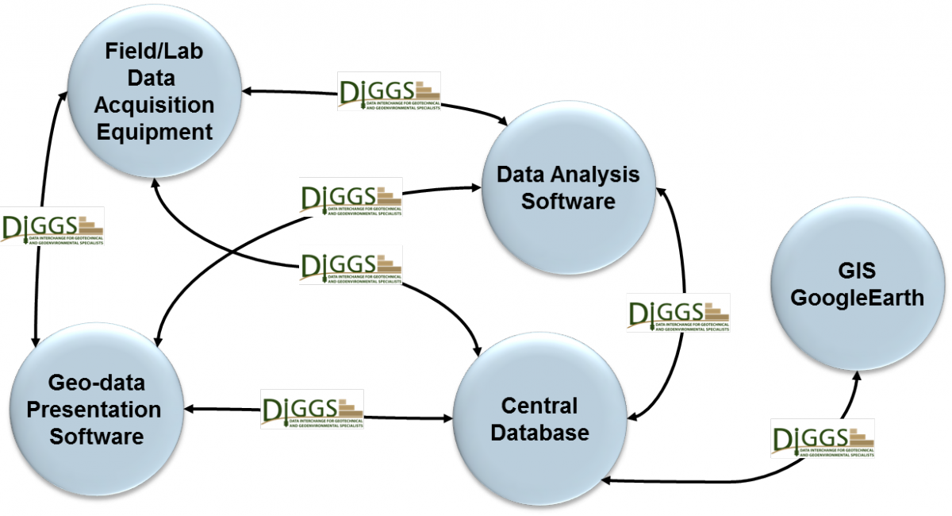
DIGGS – Data Interchange for Geotechnical and Geoenvironmental Specialists
GML (XML-based) geospatial standard schema for the transfer of geotechnical and geoenvironmental data within an organization or between multiple organizations

Slide 10
Ongoing Projects
Digital Twin Initiative by the centre for digital built Britain
understand how the construction and infrastructure sectors could use a digital approach to better design, build, operate, and integrate the built environment.
Dig2Share:
Working with industry on the importance of Ground Investigations (GI) data to the UK infrastructure. Organisations to deposit more of their Open GI data to the BGS - used in modelling and access nationally.
AGSi – working group to extend the schema to include interpreted data and ground models (incorporate 3D geology ground models)

Slide 11

Why AGS Data?
What Drivers?
Efficient data centre holding quality geoscience/sub-surface data (national hub)
Professional long-term management of data of value
Efficient delivery, access and re-use of data by many user communities
Government ‘open data’ initiatives
Future impact from data
Economic
Scientific/research
Risk reduction / inform decisions
Why AGS?
Important geoscience domain
Strong community support
Robust open pragmatic data standard
Supported by industry software and tools
Importance of metadata understood
Not static and not changing too frequently

Slide 12
Thank you Any questions?
Martin Nayembil
Data Architect
British Geological Survey
mln@bgs.ac.uk

